Slide 1




Contract Design and Conservation Incentives: Experimental Evidence from Burkina Faso
Serge Adjognon and Daan van Soest

Slide 2
1. Introduction
Payments for ecosystem services (Wunder et al. 2005)
Conservation payments conditional on service being delivered by the ecosystem service provider
Improve (private) cost-benefit ratio of conservation
(Almost) serious money – $20 bln per year
Part of the “Kyoto process”: REDD+
Also many unilateral initiatives (Sweden, US)
Not without issues/ challenges…

Slide 3
Introduction (2)
Not without issues/ challenges…:
Additionality, leakage
Pattanayak et al. (2010): “Results are highly divergent”
Still PES may be indispensable. Field-exp. evidence:
PES is effective:
Jayachandran et al. (2017), Uganda:
2-5% deforestation among treated households, 7-10% in control
No evidence of leakage
Unconditional payments may even be counterproductive
Wilebore et al. (2017), Sierra Leone:
4% additional land clearance in treatment villages
PES is a solution… for all forests on this planet?

Slide 4
Introduction (3)
Can PES be a solution for all forests on this planet?
Bulk of the PES projects implemented thus far are among (predominantly) private land owners
Costa Rica (Pfaff et al. 2008), Uganda (Jayachandran et al. 2017), Northern Ghana (van Soest et al. 2018)
Large share of forests in developing countries are “state-owned”
De facto common property resources
Common property resources
Challenge for conservation; free riding?
Challenge for PES: collective payment is a public good too?
Tragedy of the Commons:
introducing a new one to solve the other?

Slide 5
Introduction (4)
Collective PES is likely to be a social dilemma
If payments are linear in environmental service provision
E,g,, payments decreasing in deforestation share
But what if payments are threshold based?
Community receives $X if deforestation < threshold
Community receives $Y (<< X) if threshold is crossed
Thresholds change nature of the game from social dilemma to a coordination game
Strong incentives to remain below in the threshold
Privately optimal to not cut additional tree if the private loss of passing the threshold (i.e, (X – Y)/N) is larger than the benefits of cutting the tree

Slide 6
Introduction (5)
This paper:
Test whether threshold payments outperform linear payments
Reforestation, as opposed to deforestation
Implemented in 11 forests in Burkina Faso
33 “subforests” in total -- blocks
Reforestation in two plots in every block, one with linear payments, one with threshold payments
Outcome variable of interest: survival rate of the trees planted
Success depends on
extent to which collective action problem can be overcome
but also on response to lack of information

Slide 7
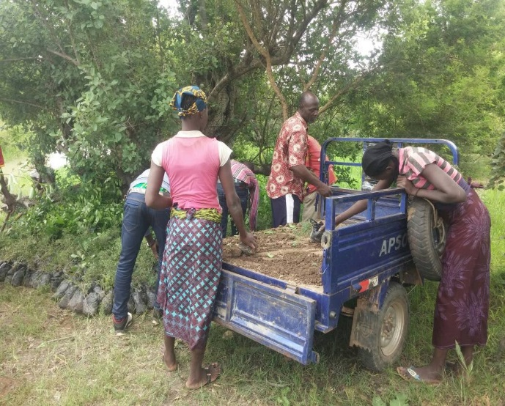
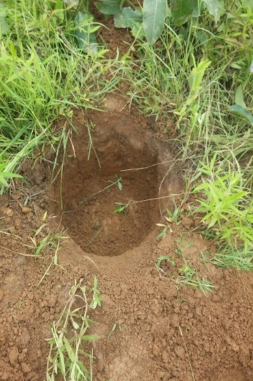
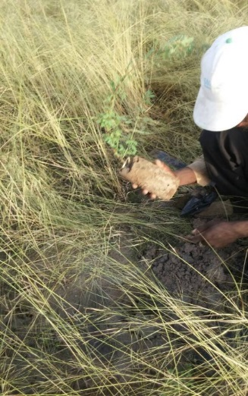
2. Design
Aug 2017: Tree planting
On degraded land within gazetted forests
Saplings planted in holes, clearing the surrounding area
Voluntary participation, private payment per tree planted
33,547 trees planted
Nov 2017: start maintenance
Linear payments, or thresholds
Random selection & treatment allocation
5 individuals & (about) 400 trees per plot, two plots per block, 33 blocks

Slide 8
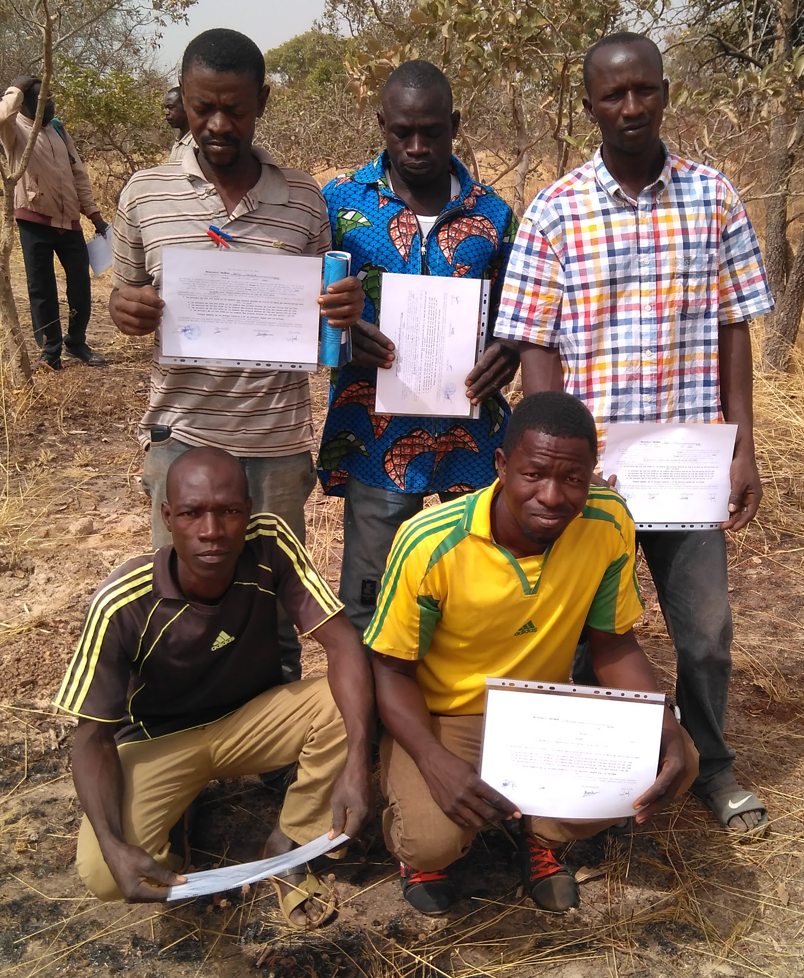
Design (2)
Linear payments
Group receives 350 FCFA (= $0.62 ) per tree still alive in May 2018
Every group member receives 1/5th
Loses 70 FCFA (= $0.12) per dead tree
Threshold payments
Group receives
135,000 FCFA (= $ 238) if # trees alive ≥ 400
105,000 FCFA if # trees alive ≥ 300
… 15,000 FCF if # trees alive < 100
Individual group member receives 1/5th
Crossing thresholds costs 6000 (= $10.60)

Slide 9
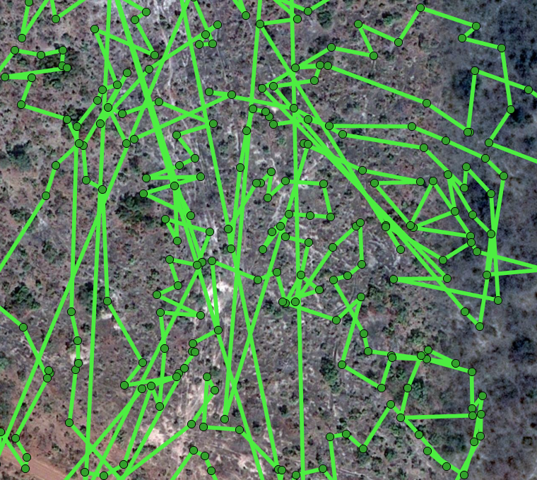
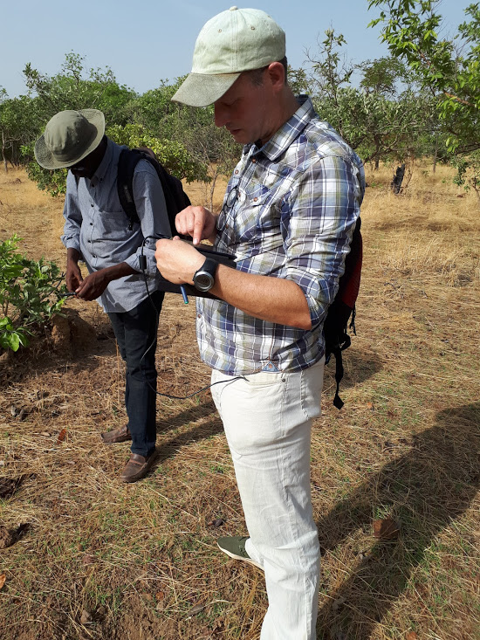
Design (3)
Checking survival rates:
Using Collector App to find back the trees in the order they were planted last year
Undoable
Alternative approach?

Slide 10
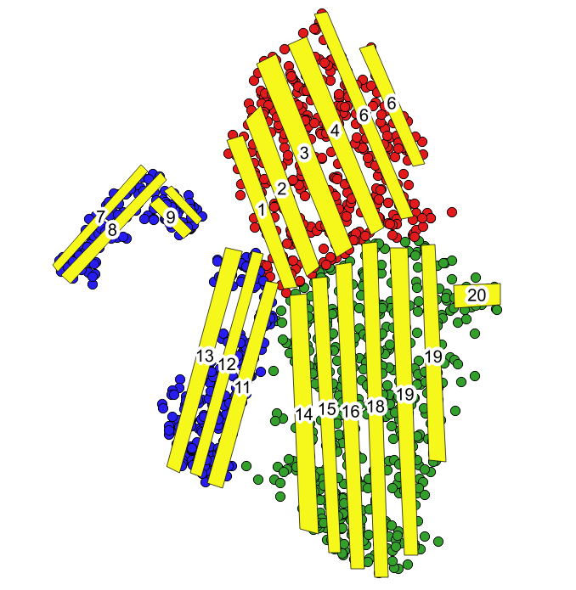
Design (3)
Checking survival rates:
Using Collector App to find back the trees in the order they were planted last year
Undoable
Alternative approach:
Create “corridors” (10m bands) covering substantial share of the land area
Count number of trees still alive in those bands… and compare to number of trees that were planted within band before

Slide 11
Design (4)
Power of the test:
not very high
Treatment allocation:
Two plots in each block
Should control for
community specifics
Balance?

Slide 12
4. Results
Survival rates:
Linear payment versus threshold payments
Quantity, but also quality

Slide 13
4. Results
Survival rates:
Linear payment versus threshold payments
Quantity, but also quality

Slide 14
4. Results
Survival rates:
Linear payment versus threshold payments
Quantity, but also quality

Slide 15
4. Results
Survival rates:
Linear payment versus threshold payments
Quantity, but also quality

Slide 16
4. Results
Survival rates:
Linear payment versus threshold payments
Quantity, but also quality
Linear payments outperform the threshold payment mechanism
in terms of trees alive
And also in terms of “quality”

Slide 17
Results (2)
Significant difference
Not very high powered
“Lucky” to find a difference?
Try to explain survival rates:
Expertise matters (“GGF”)
But also available time seems to matter
Low opp. costs (income)
Ability to buy help (assets)
I

Slide 18
Preliminary results
Mechanism: bunching just above threshold?
Compare distribution of numbers of trees alive across the treatments
Distribution under threshold just skewed more to the left; not evidence of

Slide 19
Preliminary results: Honesty ?
Overreporting?
Quite substantial in both treatments
Significantly different for threshold, but not for linear

Slide 20
Preliminary results
Bunching near threshold?
Some evidence for this; compare just below 200 to just above, and just below 400 and just above (but not significantly so)
And also not very different from linear

Slide 21
Preliminary results
Farmers neither savvy nor (too) bold in overreporting
13 of 31 farmer groups in threshold did not overreport
Of the 18 that did overreport, 10 benefitted from that – but crossed just one threshold (not more)
Mean amount of “strategic” overreporting is 94 trees (ranging from 36 to 170 trees), but none of these differences resulted in crossing more than one threshold

Slide 22
Conclusion

